Slide 1

A Project Submitted to the School of Computer Science of Yashwantrao Chavan Maharastra Open University, Nashik, in Partial Fulfillment of the Requirements for the degree of Bachelor of Computer Applications (B.C.A)
Submitted By:
Mr. EBRAHIM MITHAIWALA

Slide 2
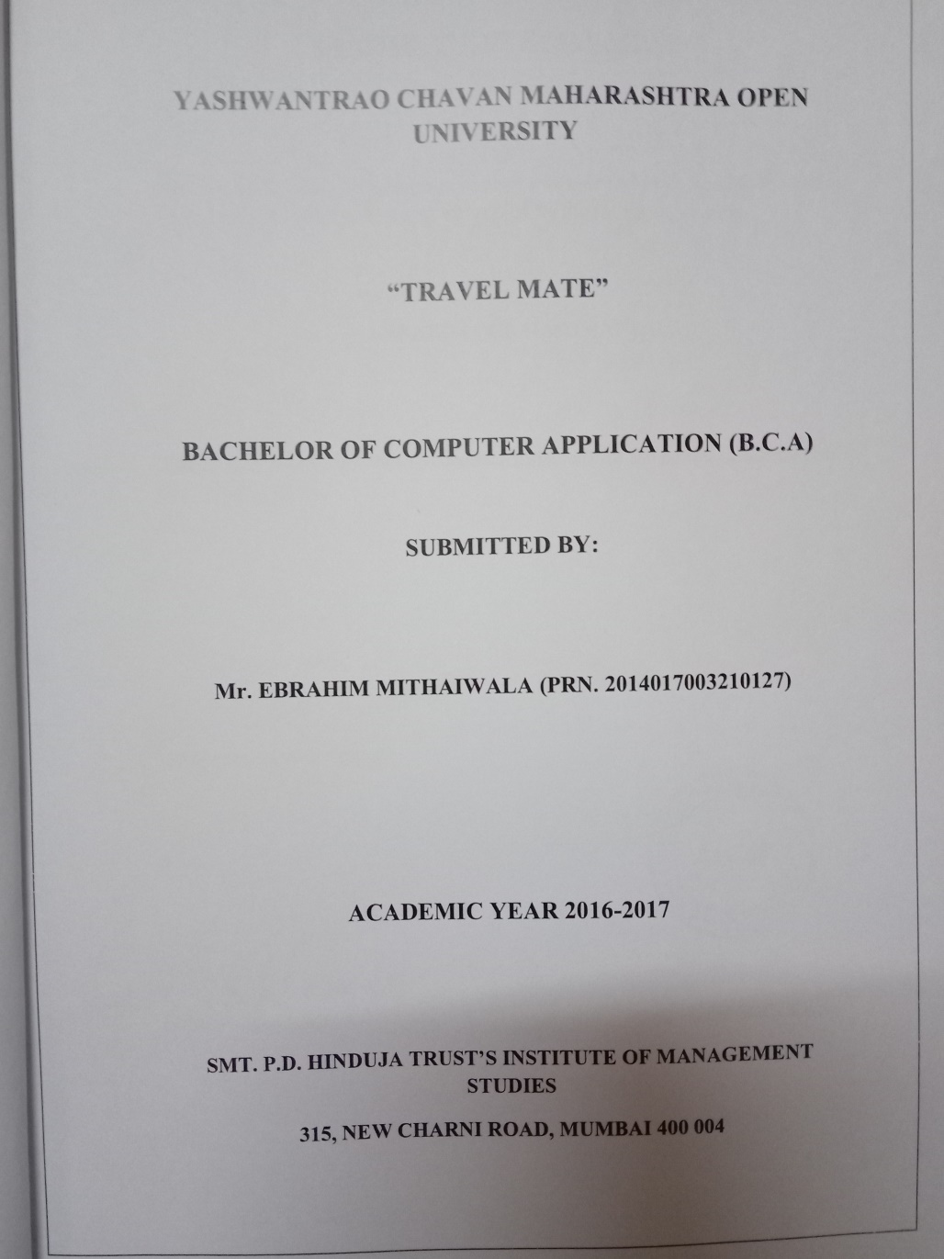
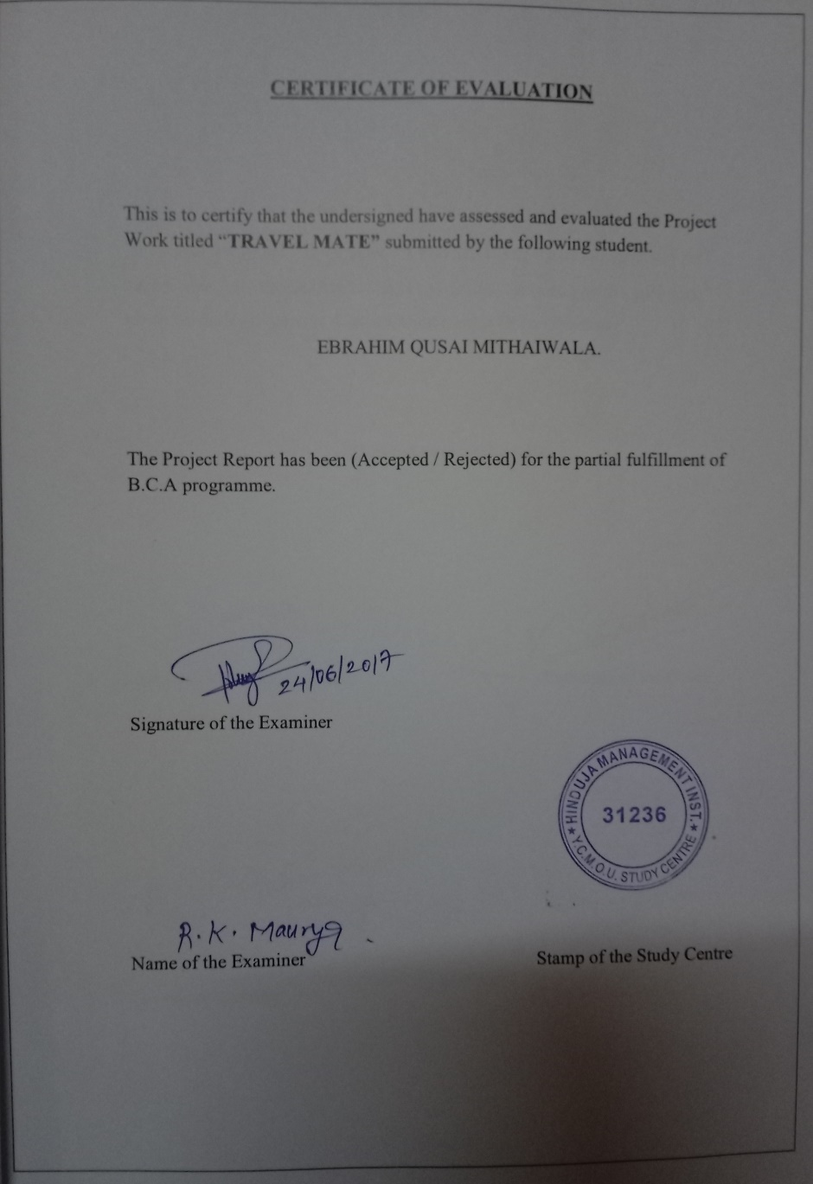

Slide 3
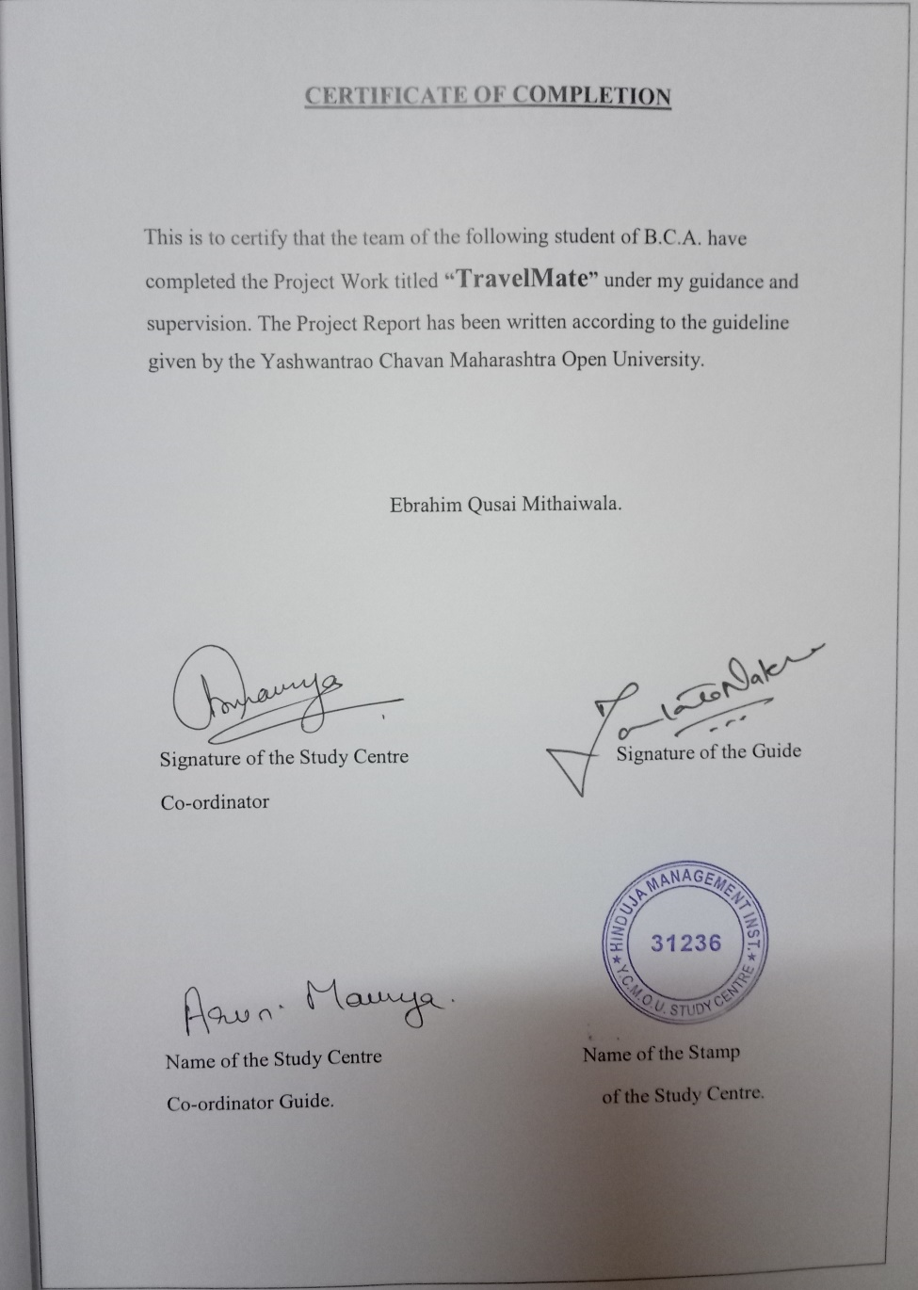
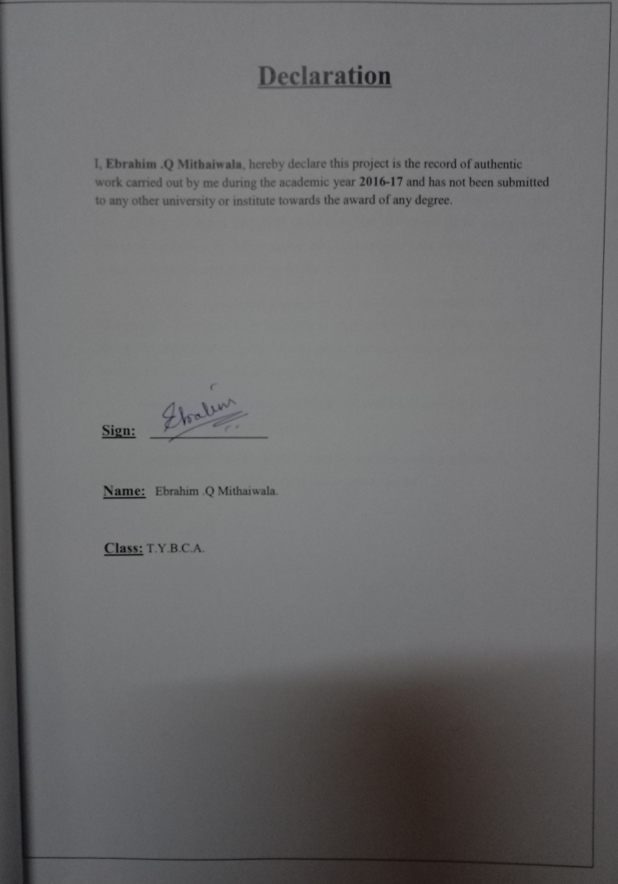

Slide 4
Introduction
Travelling at some point
Our constant Companion
Common trait of 'Forgetting‘
Small task may become Tedious
Keeping a track of our Inventory as well as your Travels
A step towards keeping your Memories Alive

Slide 5
Objectives
Helps the users in making purchase decisions before the journey.
Providing user an easy way for managing their inventory.
A handy tool for all the travellers, even can prove useful to normal school going students.
To overcome from time consuming and complicated manual procedure.
To avoid inconvenience due to manual mistake in record keeping.

Slide 6
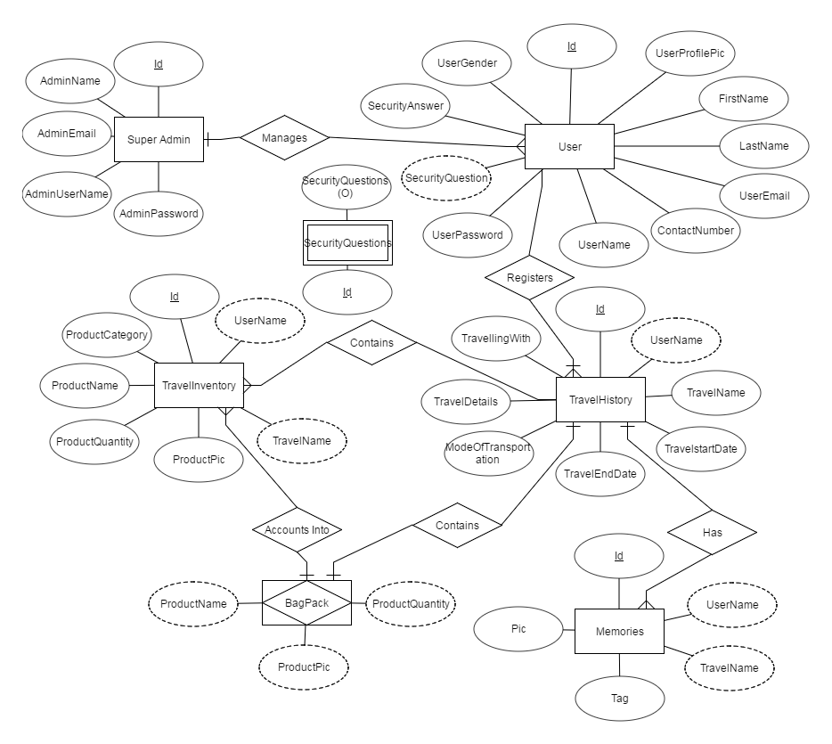
Entity Relationship Diagram(ER)

Slide 7
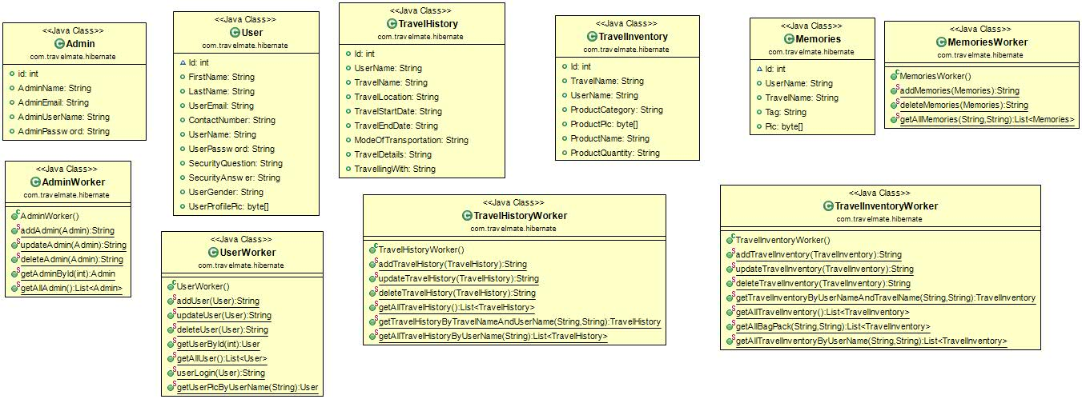
Class Diagram

Slide 8

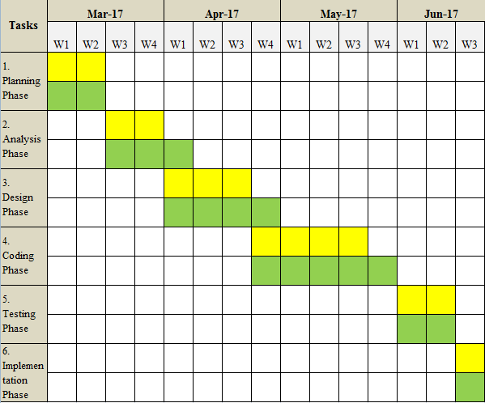
Gantt Chart

Slide 9
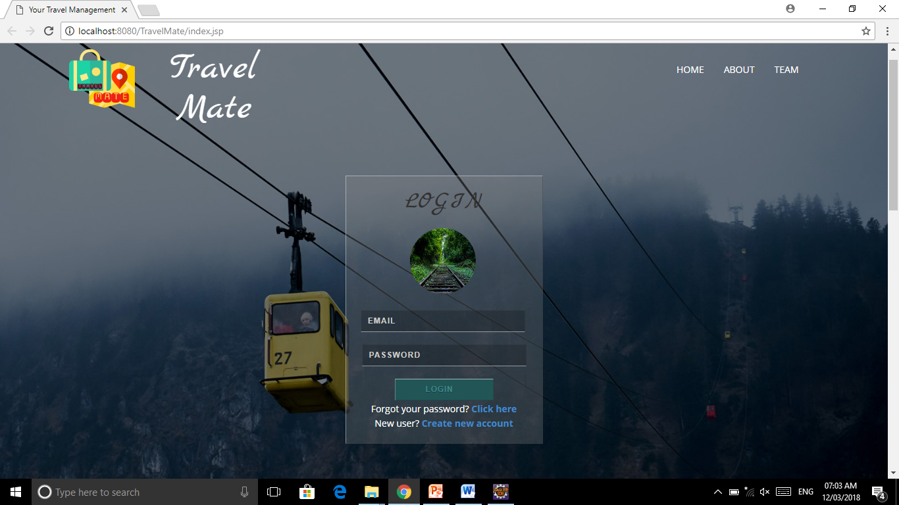

Slide 10
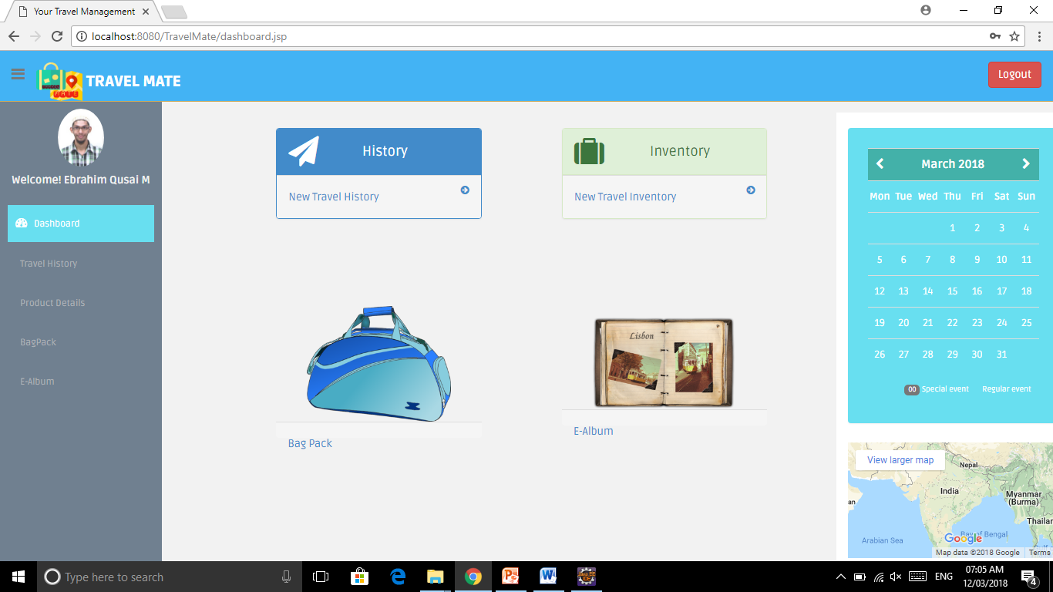

Slide 11
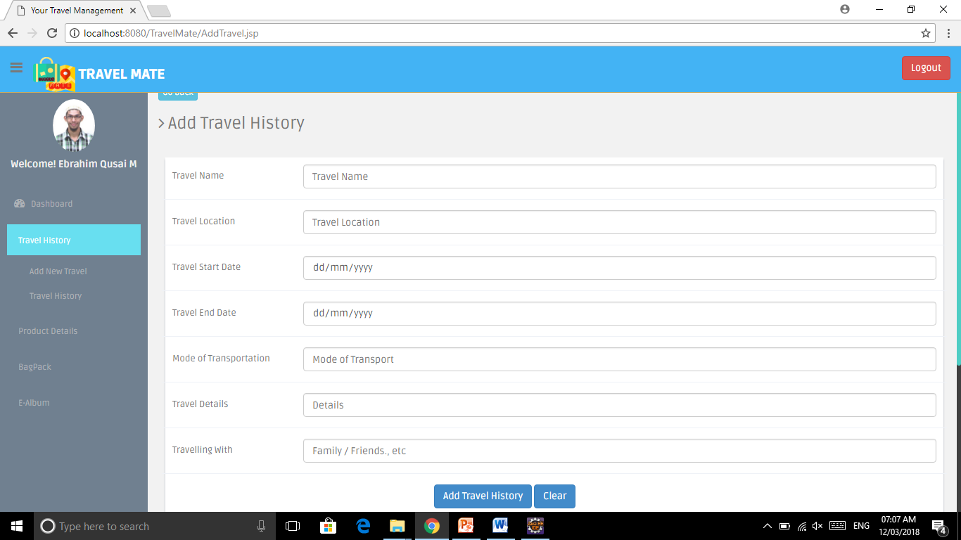

Slide 12
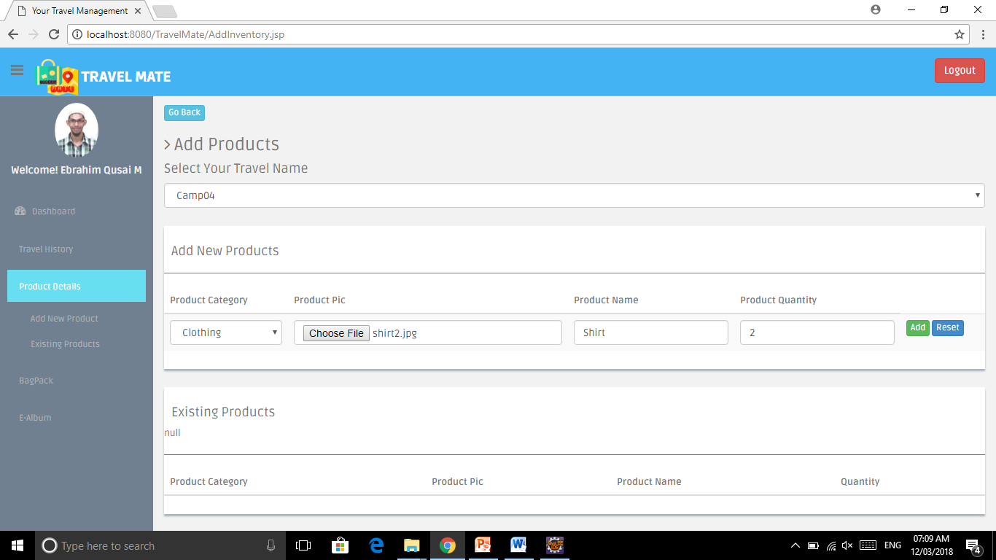

Slide 13
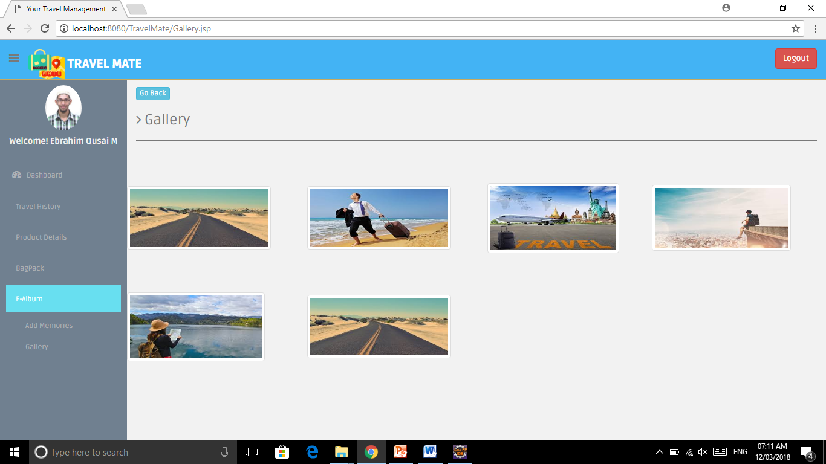

Slide 14
Advantages
Diversified Usability
Luggage management made simpler
User friendly and interactive
Bid Goodbye to Forgetfullness!
Ease to the User
A big scope for future development

Slide 15
Time For the Test Run..
Let the Travel begin..!!

